Slide 1
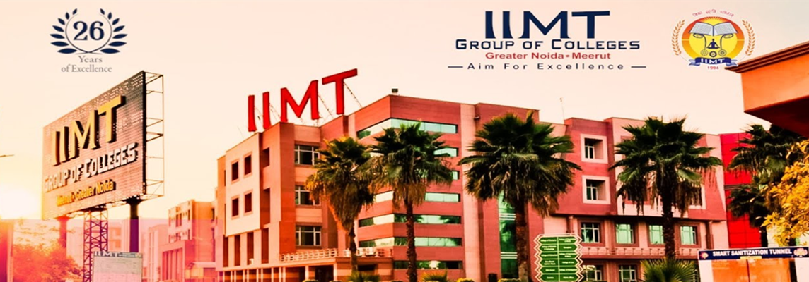
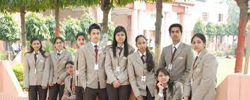
THE DIVULGENCE
QUARTERLY NEWSLETTER
MBA DEPARTMENT
IIMT COLLEGE OF ENGINEERING, GREATER NOIDA
VOLUME 6, ISSUE 6, OCTOBER 2021- DECEMBER 2021
HIGHLIGHTS OF THE ISSUE
1. Reflections from the Dean’s Desk
2. Department Spotlight
Activities in collaboration with ED cell and IIC
Curricular Activities
Co-curricular activities
3. Faculty Achievements
4.Editorial Board
Dr.Subhash Verma ,Dean (MBA).
Dr.Richa Sharma ,Chief editor.
Dr.Neha ,Editor
www.iimtindia.net | Knowledge Park - |||, Plot No. 20 – A, Greater Noida| Email: info@iimtindia.net

Slide 2
REFLECTIONS FROM THE DEAN’S DESK
At IIMT , we believe in turning the vision into reality on virtue of our commitment and sincere efforts. Being an epitome of growth and prosperity, IIMT instills in each of its faculty members and students an inspiration to be an achiever. The students not only concentrate on their academics but also on technical creativity, research and innovation.
The college encourages the faculty and students to get involved in research and innovation through various funded projects, patenting of ideas and their commercialization through startups. Entrepreneurship inclination of students is encouraged & nurtured through startup support services with an aim to drive sustainable economic growth and generate large scale employment opportunities.
In addition to Research Excellence, we believe in serving the mission of the Government of creating Entrepreneurs, based on an action plan aimed at promoting entrepreneurship and start-up guidance, training and providing hand holding support for start-up ventures to boost and encourage entrepreneurship .
Dr. S.K VERMA
DEAN
IIMT College Of Engineering
Greater Noida

Slide 3
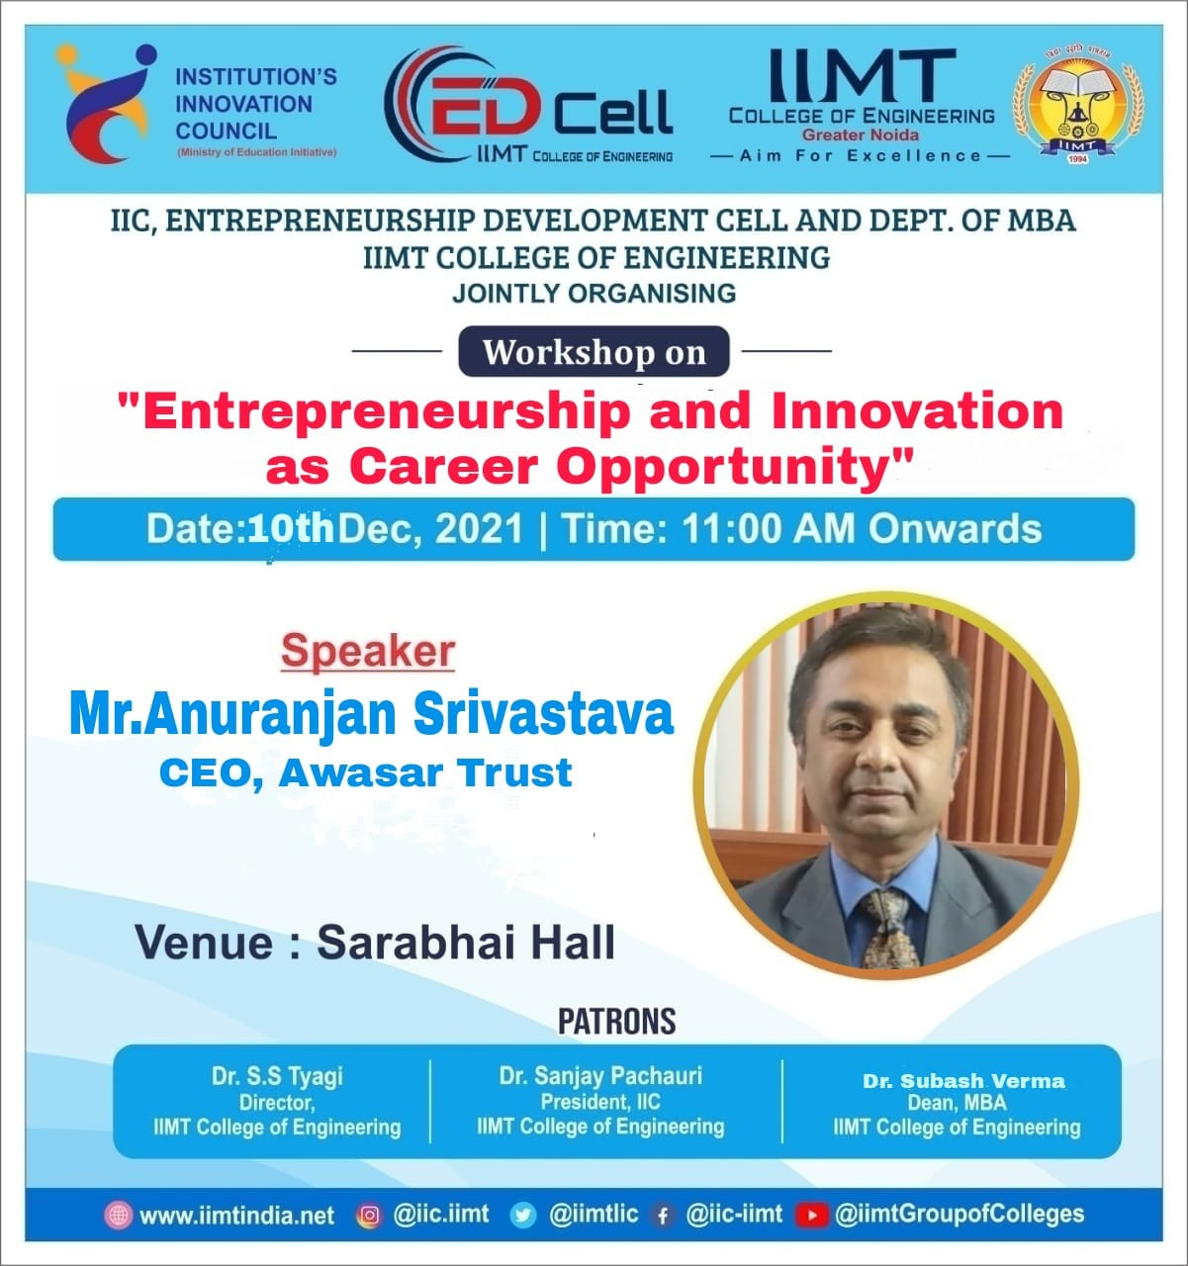
Activities in collaboration with ED CELL AND IIC
WORKSHOP
A Workshop on “Entrepreneurship and Innovation as Career Opportunity” was conducted by ED cell and IIC-IIMT College of Engineering, Greater Noida campus, Uttar Pradesh on 10th December,2021. This event was coordinated by department of MBA & MCA. The event coordinator Dr. Vivek Rastogi and Mr. Ajay Nandan Srivastava invited and introduced the guests, followed by The Welcome Note given by Dr. S K VERMA, Dean MBA, Prof, R K TOMAR (HOD-MBA). The coordinator introduced the speaker to the participants. Speaker shared his knowledge about the role of entrepreneurship and innovation in achieving the success in life. The event was hosted in Offline mode, thereby it was attended by more than 75 participants. The vote of thanks for the event was given by Dr. K.N. Chaubey.

Slide 4
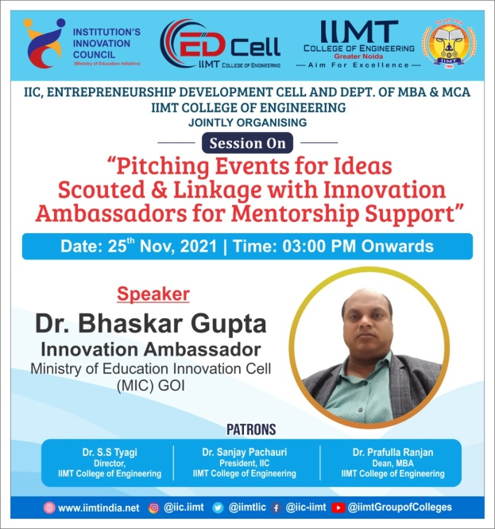
GUEST LECTURE
A Session On “Pitching Events For Ideas Scouted & Linkage With Innovation Ambassador For Mentorship Support” was conducted by ED cell and IIC-IIMT College of Engineering, Gr. NOIDA campus, Uttar Pradesh on 25th November,2021. This event was coordinated by department of MBA & MCA. The event coordinator Mr. Ajay Nandan Srivastava and Mr. Manikeshwar Rai, invited and introduced the guests, followed by The Welcome Note given by Dr. Prafulla Ranjan, Chairman, ED Cell, Dr. Naveen Sharma (HOD-MCA) The coordinator introduced the speaker to the participants. Speaker shared his knowledge about how to pitch a business idea depending upon the situation. This will help students to know about innovation necessary for the business .The event was hosted in Offline mode, thereby it was attended by more than 90 participants. The vote of thanks was given by Dr. K.N. Chaubey.

Slide 5
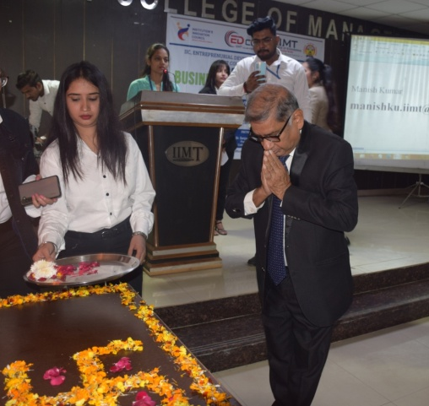
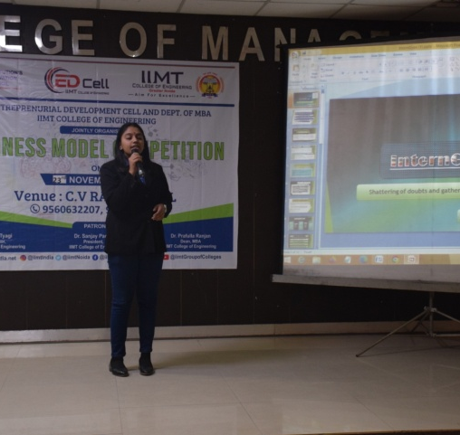
Business Model Competition
The event was conducted by the ED Cell and IIC-IIMT College of Engineering, Greater Noida campus, Uttar Pradesh on 23rd November,2021. It was coordinated by the Department of MBA and hosted in an offline mode. The Strategy and Consulting event attracted wide participation from Delhi NCR. A total of 18 teams from Delhi NCR including 15 home teams contested for the coveted “ Best Business Model Award” .

Slide 6
GUEST LECTURE
A session on “ How creative you are” was conducted by ED cell and IIC-IIMT College of Engineering, Gr. NOIDA campus, Uttar Pradesh on 13th November,2021. This event was coordinated by department of MBA. The event coordinator Mr.Jitendra Singhal, invited and introduced the guests, followed by Welcome Note given by Dr. Prafulla Ranjan, Chairman, ED Cell. The coordinator introduced the speaker to the participants. The guest speaker Dr. Sunita Singhal shared her knowledge about the role of creativity in fulfilling the dreams and achieving success in life.The event was hosted in Offline mode, thereby it was attended by more than 88 participants. The vote of thanks Note for the event was given by Dr. K.N. Chaube thereafter the event was concluded.

Slide 7
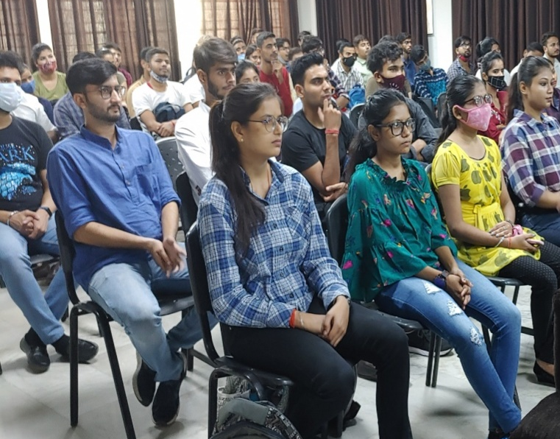
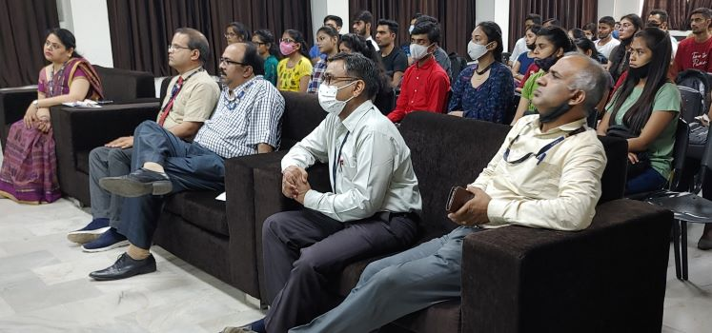
CURRICULAR ACTIVITIES
BUSINESS QUIZ
The Business Quiz: Buzzard (Minor activity) was conducted by MBA Department-IIMT College of Engineering, Gr. NOIDA campus, Uttar Pradesh at Sarabhai Hall on 13th October 2021. This event was coordinated by Dr. Pratibha Goswami Associate Professor, MBA Department, IIMT College of Engineering, Gr. NOIDA.
STUDENT FEEDBACK
“Enjoyed the event”, Abu Hamza (Winner, MBA 1st Year)
“Fun filled informative event”, Supriya Sharma (MBA 2nd Year) “Gained knowledge about new things”, Rajat Pandey (MBA 2nd Year)

Slide 8
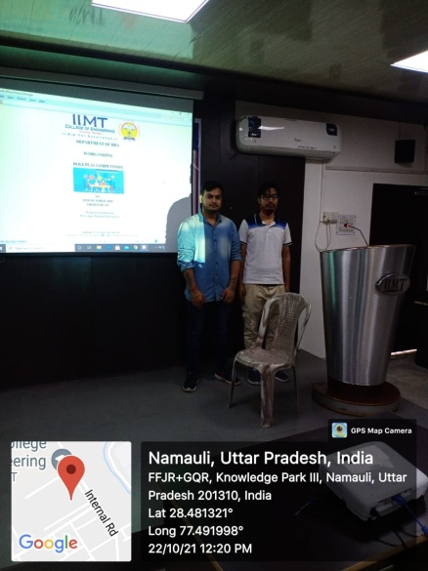
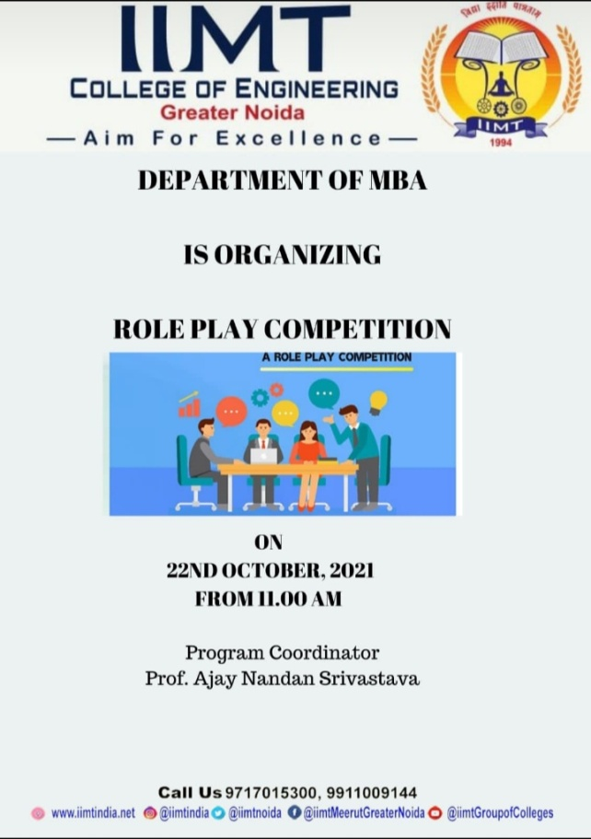
ROLE PLAY COMPETITION
A wonderful role play Competition was organized by MBA department on 22 October, 2021at 11:00 am on Sarabhai hall. There are six teams from MBA 1st year and MBA 2nd year . Students had given 10 minutes for present their views with using timer. Prof Jitendra Singhal and Dr. Pratibha was the judge on this event.

Slide 9
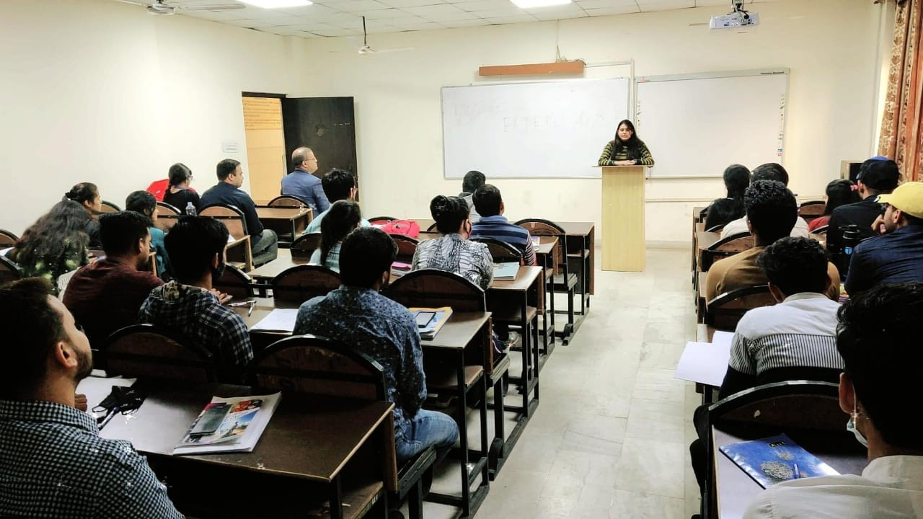
Extempore
‘Speech is the mirror of the soul; as a man speaks, so he is’
A minor activity, Extempore Competition was organized for MBA I semester students on November 11, 2021. The competition took place with an objective of polishing the spoken abilities of the students. The activity helps in improving them not only as good speakers but also observant and responsible management professional who have an opinion and awareness about the issues of local, managerial and global concern. The event was a learning experience not just for the participating students but also for the audience. The judges appreciated the enthusiasm among the students who participated in the event. Total 73 students took part in the competition. The event was conducted by Dr. Richa Sharma and Dr. Vivek Rastogi.

Slide 10
GUEST LECTURE
A wonderful Guest Lecture on topic Post Pandemic: Industry Preview was organized by by MBA department on 20th October,2021. The event was attended by the students of MBA Sem-1 & Sem 3. The guest speaker Prof (Dr) Meenakshi Kaushik started her lecture by explaining about the industry and how it will change in the near future. She also spoke to the students on the various scope in industry for the newcomers and the challenges they will face when they enter this competitive industry. He then cleared all the doubts and queries of the students and made them feel positive towards their career. As the session was very helpful for the students, to understand the situation after COVID-19 Pandemic. The students also felt that the Guest Lecture will be very helpful for them for their future life and academics.

Slide 11
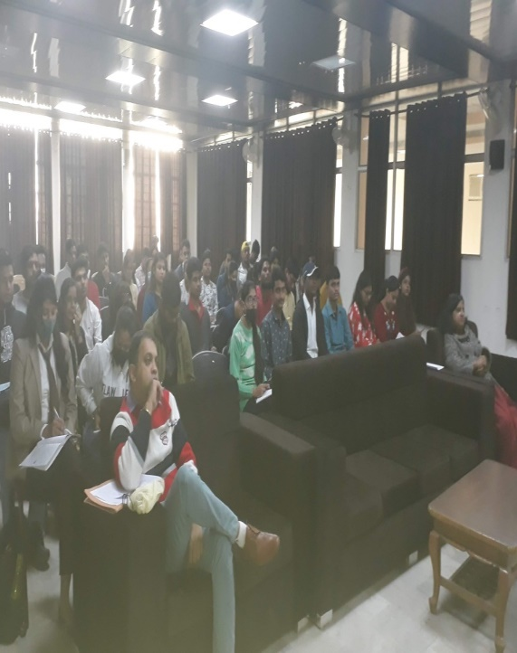
DEBATE COMPETITION
A wonderful debate organized on 17 November,2021 at 10.30 am on Sarabhai hall by MBA department. Both MBA 1ST year and 2nd year students were participated in the competition. The aim of the competition was to hone public speaking skills of the students and teach them to be articulate while expressing their thoughts and opinions. Prof Jitendra Singhal and Dr. Pratibha was the judge on this event. The session was a kaleidoscope of opinions, thoughts, ideas and perspectives that definitely enhanced the knowledge and understanding of the topic among students

Slide 12
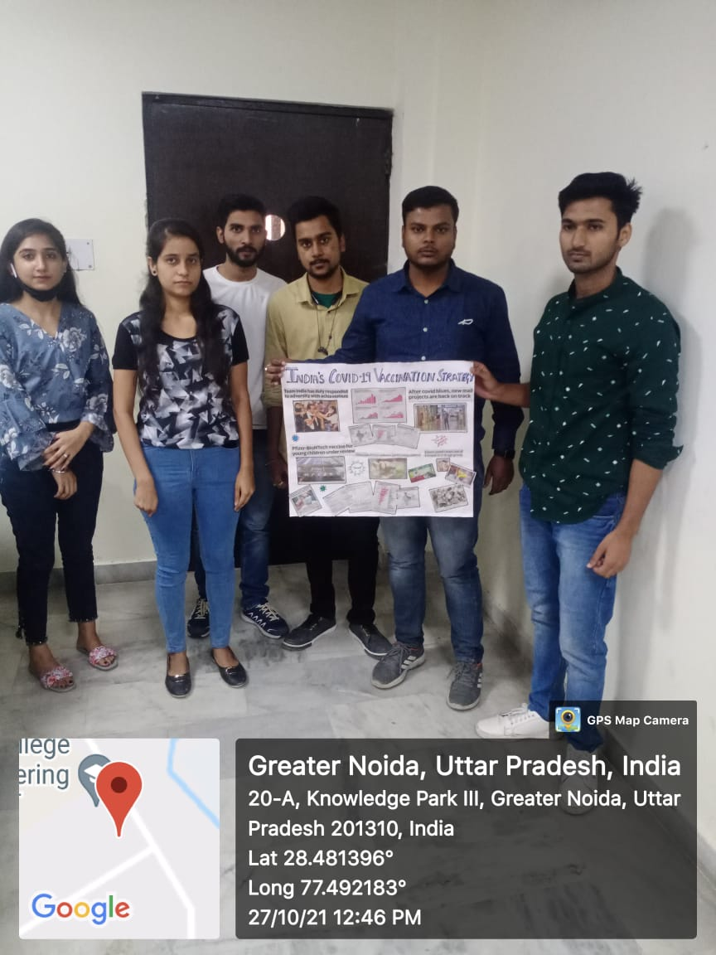
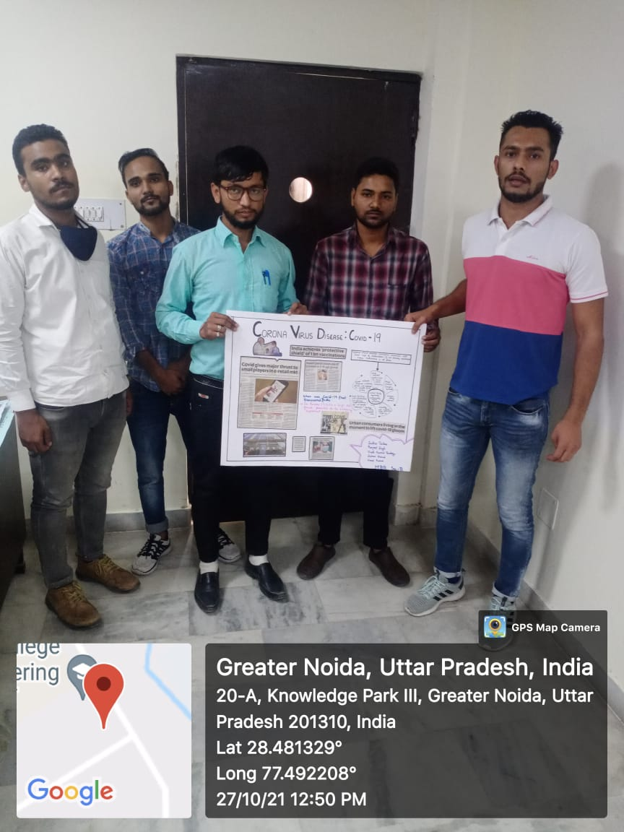
CO-CURRICULAR ACTIVITIES
Collage making competition
On 27th Oct, 2021, students of MBA 1st& 2nd Year participated in a minor activity called COLLAGE MAKING COMPETITION organized by Department of MBA. The event was conducted in two slots between MBA 1st& 2nd Year students. In first slot the participants need to prepare a collage poster on Chart paper or sketch on a sheet on their topics .In second slot all the participants gave presentations on their topics within five minutes time frame.

Slide 13
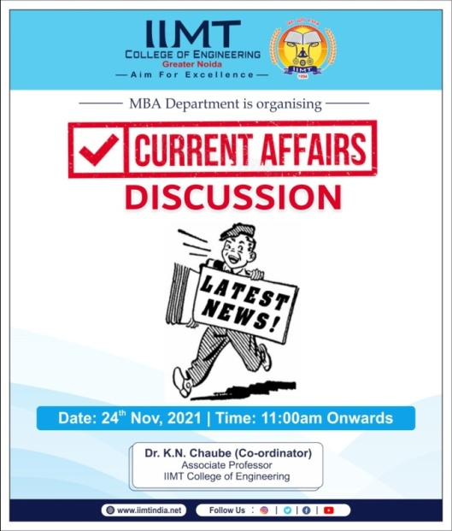
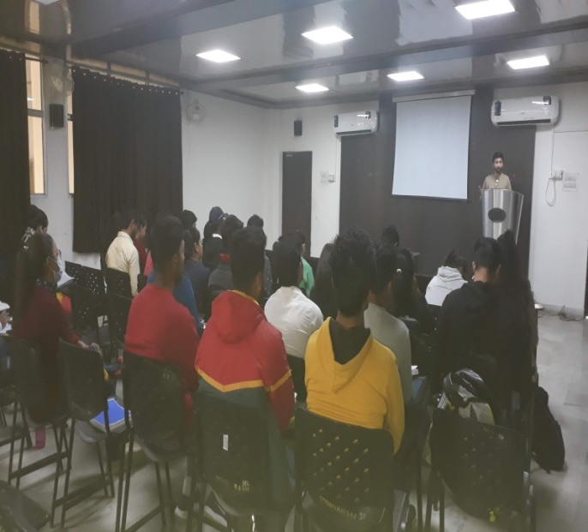
CURRENT AFFAIRS
A Discussion on Current Affairs was organized by MBA Department on 24th November,2021 to enhance Leadership skill, communication skill, Listening skill, Assertiveness and Confidence level of students in order to succeed in complex business environment. The event was planned to supplement class room teaching with the need of abstract thinking to succeed in business. The Topic of Discussion was Current political scenario and its impact on Indian Economy

